Slide 1

Soaring through the Clouds – The Sequel Live Demo Cloud Native Microservices Architecture
Oracle Emerging PaaS Partner Community Forum 2019
April 8th - 10th 2019 Mallorca, Spain

Slide 2

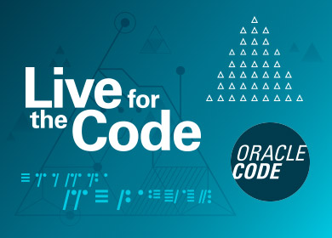



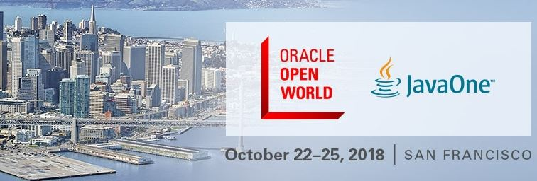


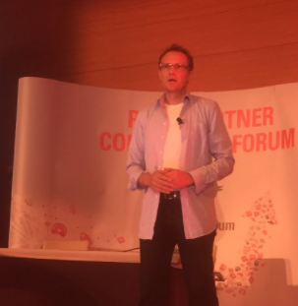


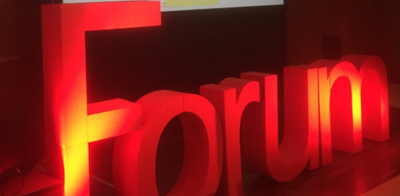
2019

Slide 3







Slide 4
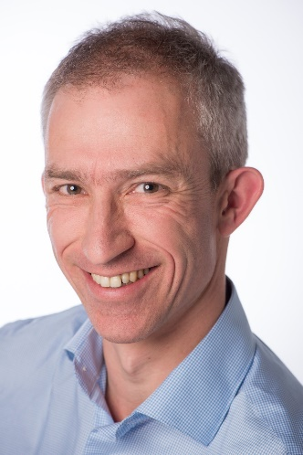
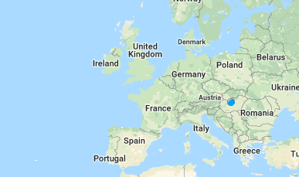



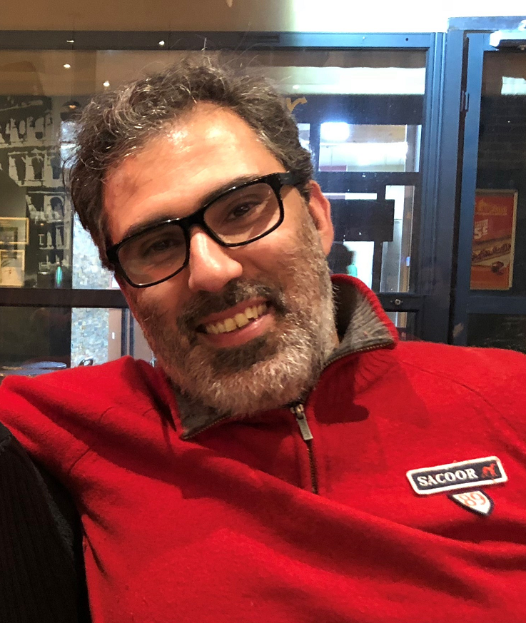
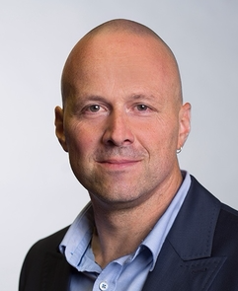
The Team

Slide 5
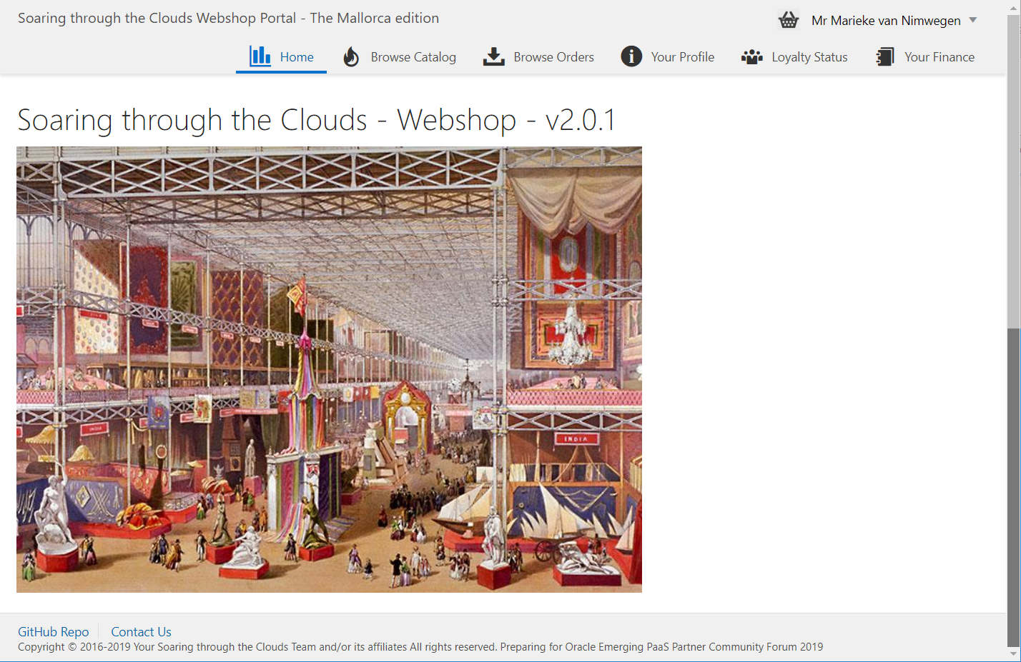
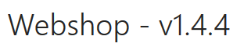
Meet Our Web Shop
Notes:
start with a demo of the Webshop - from customers signs and browses the products catalog to check out of the shopping basket, composing the order with delivery details and submitting the order; then checking the invoices and perhaps making the payment, reviewing the loyalty points and status and finally checking on the order progress (as the order gets picked, shipped and finally delivered).

Slide 6
What’s the IT behind the Webshop?
Web Shop Portal
µ Customers
µ Orders
µ Products
µ Loyalty
µ Finance
µ Customers
µ Logistics
µ Orders
µ Products
µ Loyalty
µ Finance
µ Shipments
Notes:
dazzle the audience with a quick dump of all technologies (and cloud services) used for putting the webshop together - for the UI, the API implementation, the datastores and the event bus.

Slide 7





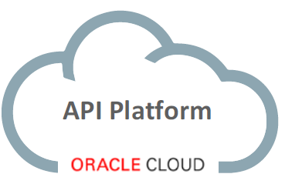
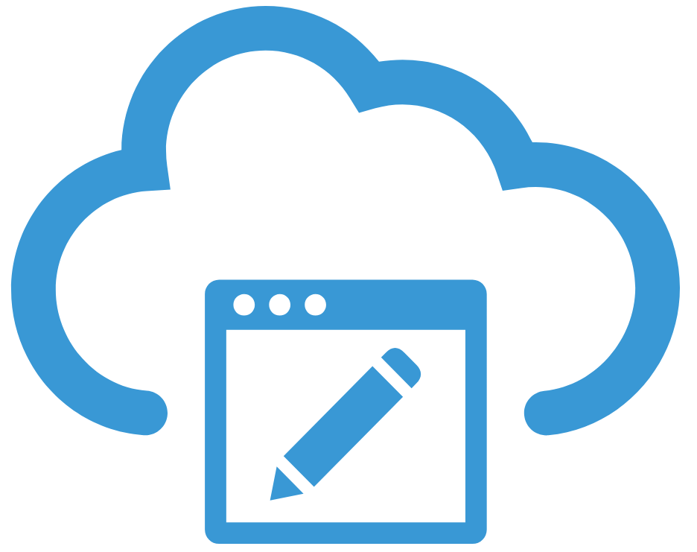


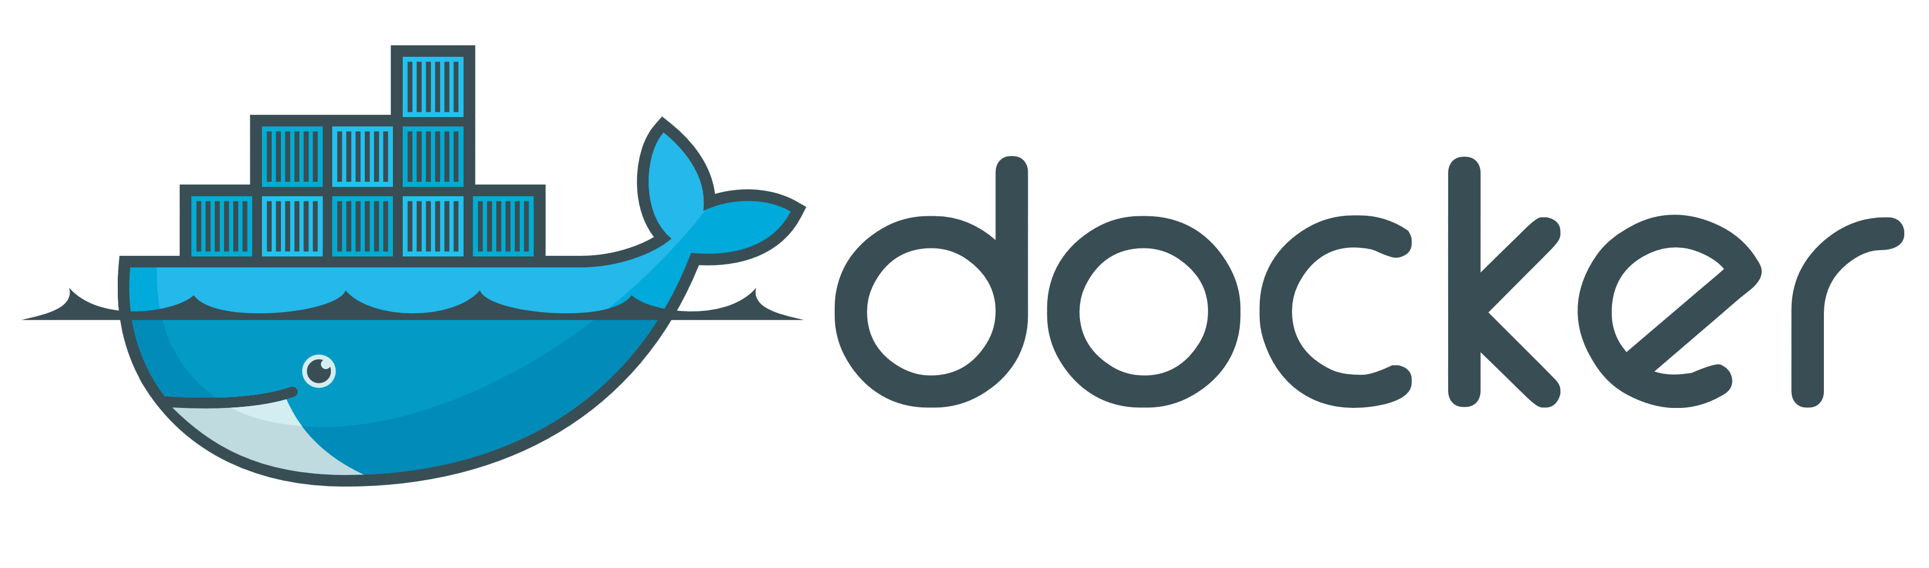
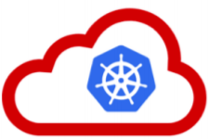






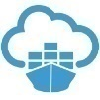


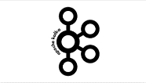

API Portal
Web Shop Portal
µ Customers
µ Orders
µ Products
µ Loyalty
µ Finance
API Platform
Backoffice UI
λ
Event Schema Registry
Event Hub
Notes:
dazzle the audience with a quick dump of all technologies (and cloud services) used for putting the webshop together - for the UI, the API implementation, the datastores and the event bus.

Slide 8

Events and Process through Choreography
Customer Sign In
Add To Shopping Cart
Order Created
Web Shop Portal
µ Finance
µ Loyalty
µ Customers
µ Products
µ Orders
µ Shipping Status
µ Customers
µ Logistics
µ Orders
µ Products
µ Loyalty
µ Finance
Order Picked
Shipping News
Notes:
There is no process orchestration. The events trigger activity across domains and so a process arises.

Slide 9
Events and Process through Choreography
Pick Order
Ship Order
Sign In
Shop Products into Cart
Create Order
Generate Invoice
Collect Payment
Sign Up
Calculate Loyalty Points
Record Loyalty Status
Notes:
There is no process orchestration. The events trigger activity across domains and so a process arises.

Slide 10
Blockchain based Shipper Marketplace
API Portal
Web Shop Portal
From Complete Order wizard: Invoke issueShipmentRequestto gauge marketplace for shipping-offers
µ Orders
4'
1
API Platform
Shippers Marketplace API receives request and publishes event on blockchain
Logistics MS reads the events that are published when the shipment is pickedup by the shipper and when it is received by the customer
2
Logistics MS
Blockchain based Shippers Marketplace
Orders MS
From select shipment: invoke selectShipment in marketplace
5
Shipper A
7
6
Shipper B
3
3
Shippers receive event on blockchain and create their best offer; This is published on the event bus
4
ShipmentOffers are read by Orders MS so they can be presented in the portal.
6'
7'
3'
Event Bus
Notes:
dazzle the audience with a quick dump of all technologies (and cloud services) used for putting the webshop together - for the UI, the API implementation, the datastores and the event bus.

Slide 11
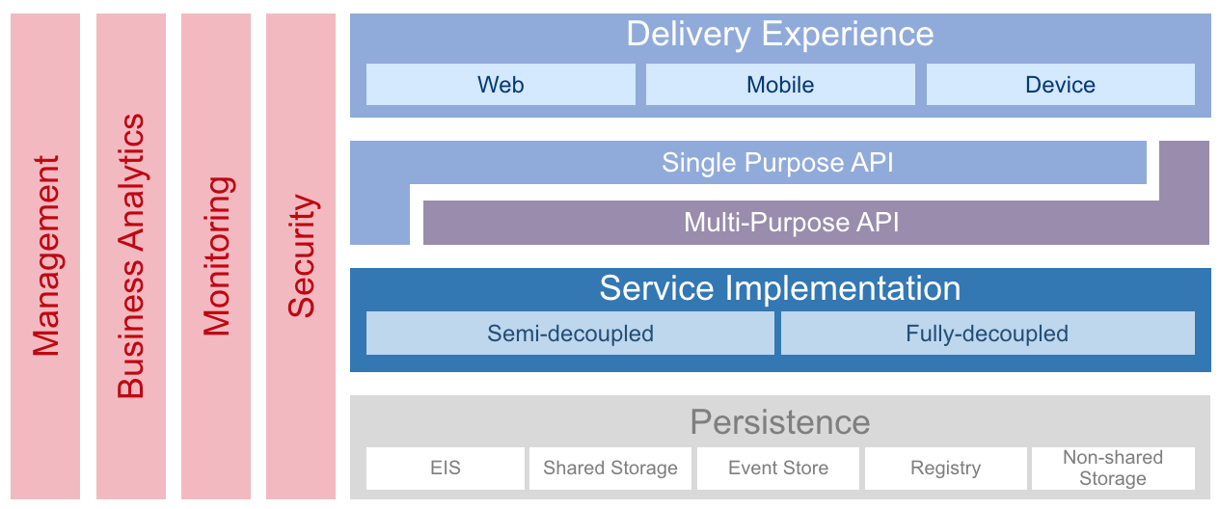
OMESA Architecture

Slide 12
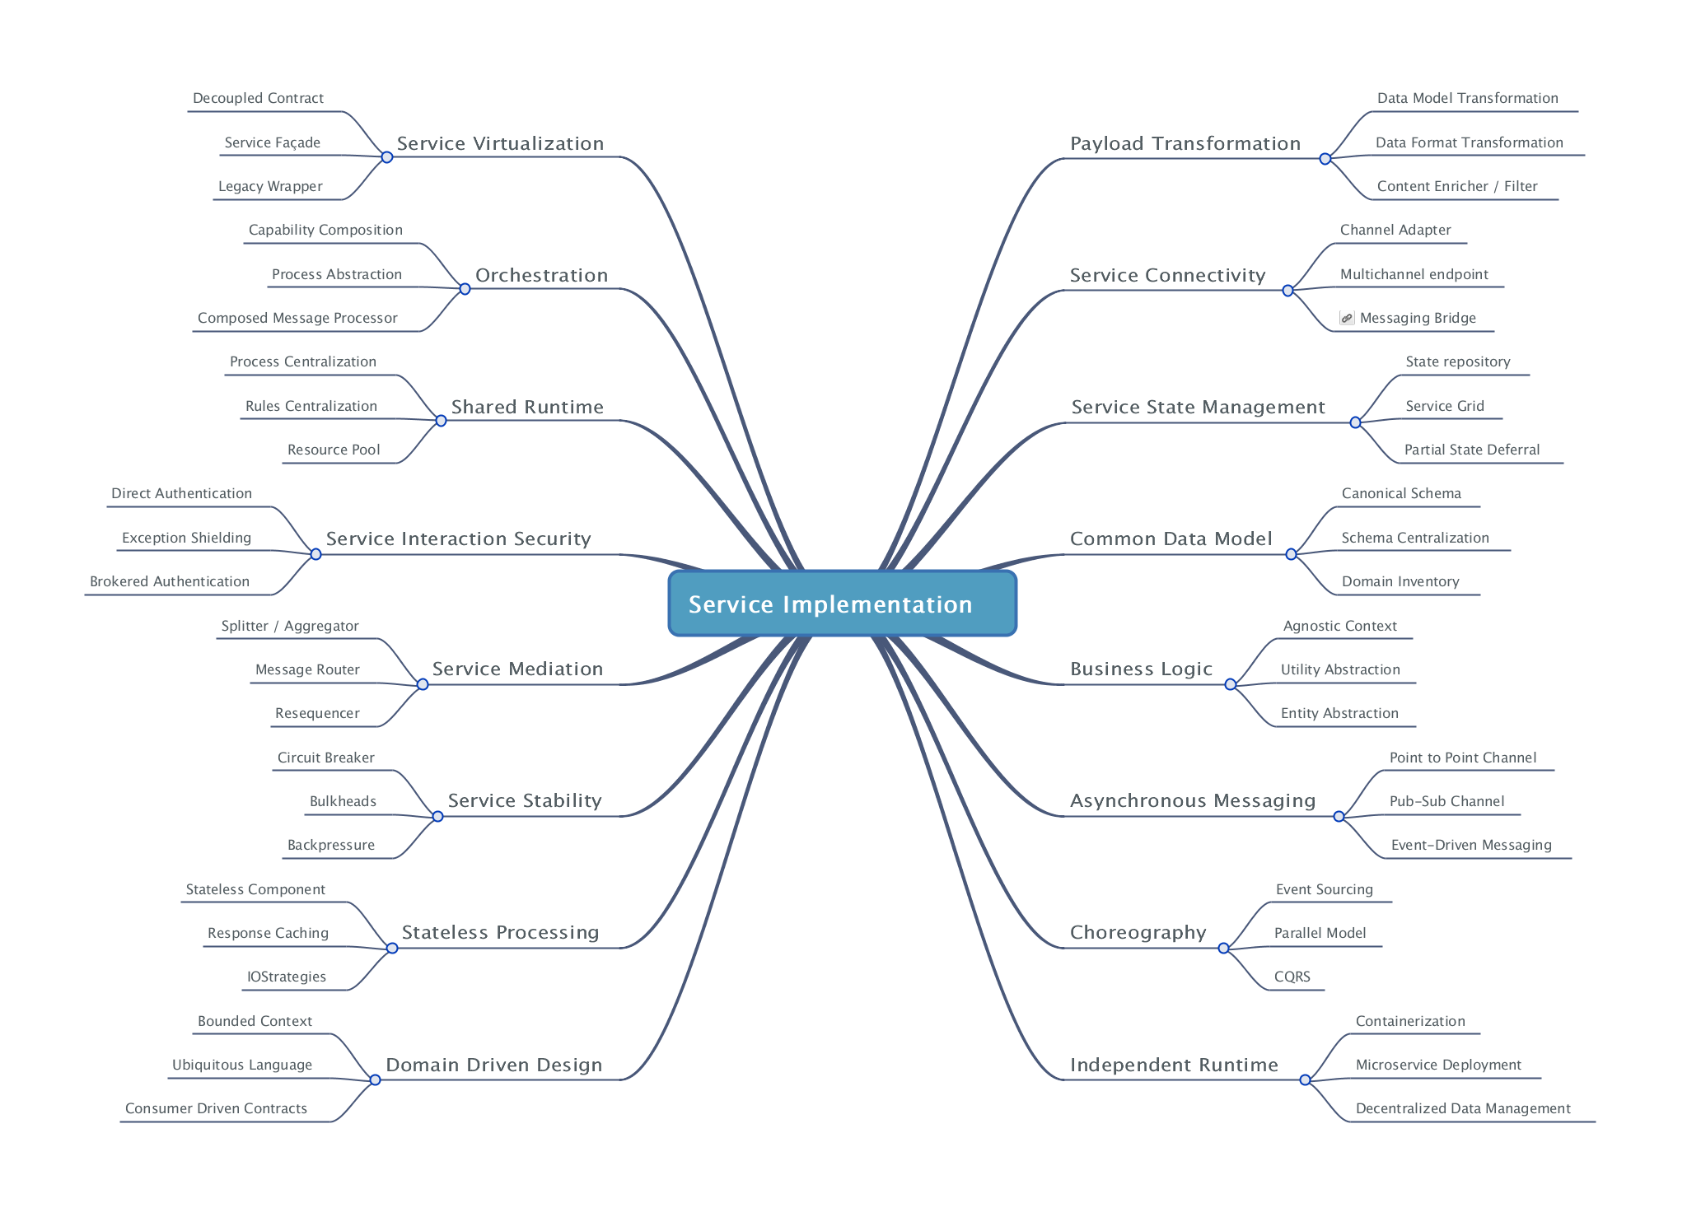
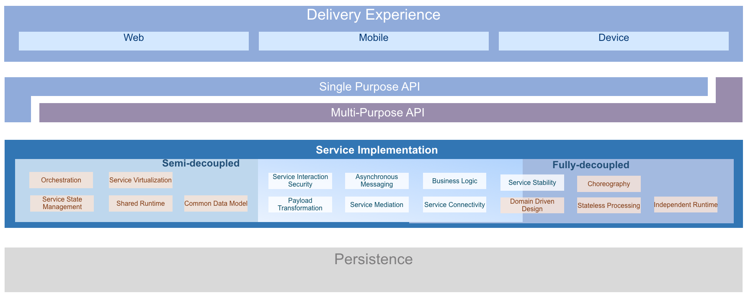
OMESA - Capabilities and patterns

Slide 13
Microservices Architecture
Microservices are not the silver bullet!
Important concepts:
Choreography (vs. Orchestration in classic SOA environments)
Bounded Context (Domain Driven Design)
DevOps: Teams taking ownership for Dev & Ops (”You built it, you run it!”)
But: Good fit for our use case, since increased
Flexibility: Comprehensible, maintainable, independently releasable
Scalable
Fault tolerant & robust
Benefit from technological innovation (without enterprise risk & impact)
Notes:
spend a little time on microservices - why decided to apply a microservices architecture (objectives, expectations) and how we designed the architecture in our case (link to Omesa?). What were the rules and assumptions. Here we can perhaps show how we use Slack and GitHubExplain in some details what important role events played. Maybe at that point also discuss the workflow (@Luis Weir’s article and our discussions around that).Perhaps we can use the Event Monitor Dashboard (that shows all on EventHub/Kafka events on a timeline ) to illustrate the story on the events (and the Order workflow)

Slide 14
Microservices Architecture Design & Implementation Characteristics (12-factor)
Are encapsulated and stand-alone
Stateless and horizontally scalable
Offer REST APIs
Expose configurable properties – such as endpoints of dependencies
Are released & deployed & scaled independent of each other
They can be co-located but they do not have to
Continuous Delivery – including automated build and test – are applied
Publish events and consume (relevant) events from central event bus
Are responsible for their own data
take care of persistence in a fitting data store
Also manage the bounded context: data owned by/derived from other microservices that the service requires to function independently and at speed
Even though not required, containers are a popular vehicle for build, ship and run
Kubernetes is becoming the de facto standard container management runtime platform
Notes:
spend a little time on microservices - why decided to apply a microservices architecture (objectives, expectations) and how we designed the architecture in our case (link to Omesa?). What were the rules and assumptions. Here we can perhaps show how we use Slack and GitHubExplain in some details what important role events played. Maybe at that point also discuss the workflow (@Luis Weir’s article and our discussions around that).Perhaps we can use the Event Monitor Dashboard (that shows all on EventHub/Kafka events on a timeline ) to illustrate the story on the events (and the Order workflow)

Slide 15
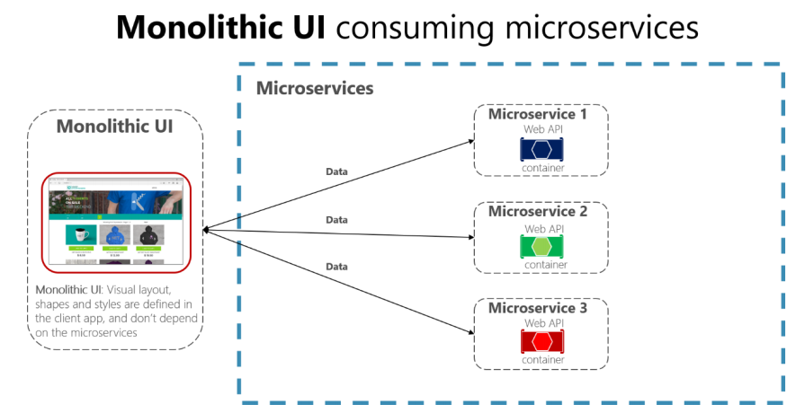
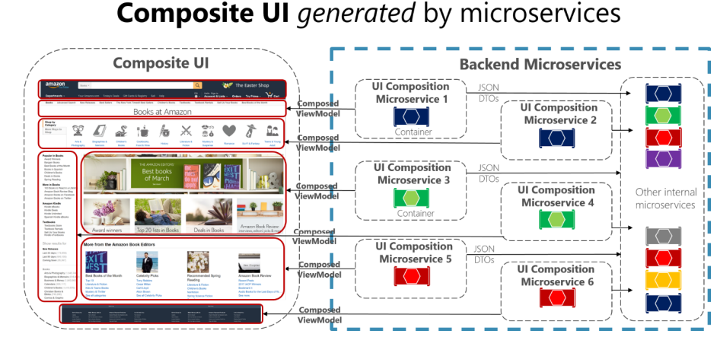
Microservices Architecture User Interface
Is UI part of Microservice?
VS.
Notes:
spend a little time on microservices - why decided to apply a microservices architecture (objectives, expectations) and how we designed the architecture in our case (link to Omesa?). What were the rules and assumptions. Here we can perhaps show how we use Slack and GitHubExplain in some details what important role events played. Maybe at that point also discuss the workflow (@Luis Weir’s article and our discussions around that).Perhaps we can use the Event Monitor Dashboard (that shows all on EventHub/Kafka events on a timeline ) to illustrate the story on the events (and the Order workflow)

Slide 16
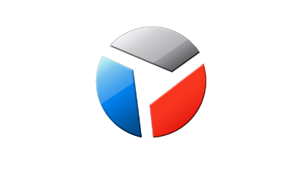
Web Shop Portal Solution Design
Web Shop – Customer User Interface
CustomerSignIn,
ChangedProfileSettings
Client Side (JS) Event Bus & Routing
Context (user settings, navigation history, ..)
Menu & Nav
Marketing content
IFRAME
IFRAME
IFRAME
IFRAME
IFRAME
ViewProduct
InspectInvoice
AddToBasket
Sign Up
Sign In
Edit Profile
µ Customers
µ Orders
µ Products
µ Loyalty
µ Billing, Invoicing & Collection

Slide 17
Microservices Architecture Organizational aspects
Doing Microservices seriously, implies change!
Dedicated responsibility throughout a Microservices lifecycle
Breakthrough the traditional borders between Dev and Ops guys
One have to come out of the own comfort zone
Starting a Microservice initiative means a improved need for communication, because of
API definitions
Events and interactions
Defining Bounded contexts is not straight-forward and might conflict with organizational aspects

Slide 18








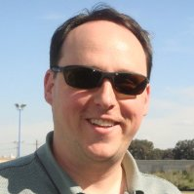
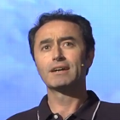

Ways of Working – A Multi Team Effort
Web Shop Portal
µ Customers
µ Orders
µ Products
µ Loyalty
µ Finance
Notes:
dazzle the audience with a quick dump of all technologies (and cloud services) used for putting the webshop together - for the UI, the API implementation, the datastores and the event bus.

Slide 19
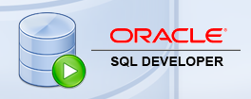
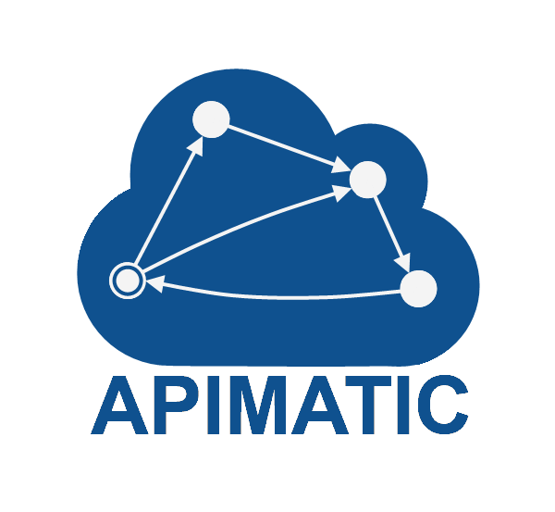


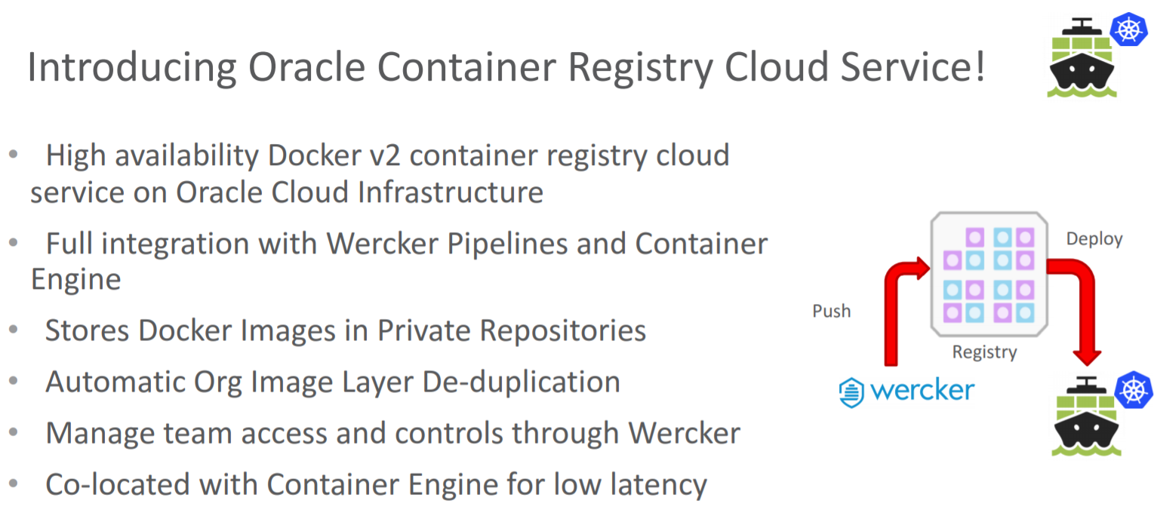




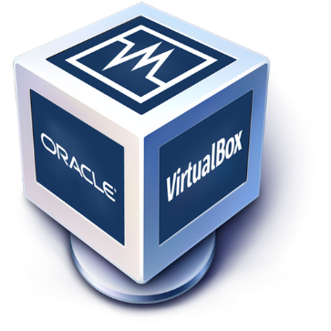


Design Time Toolset

Slide 20
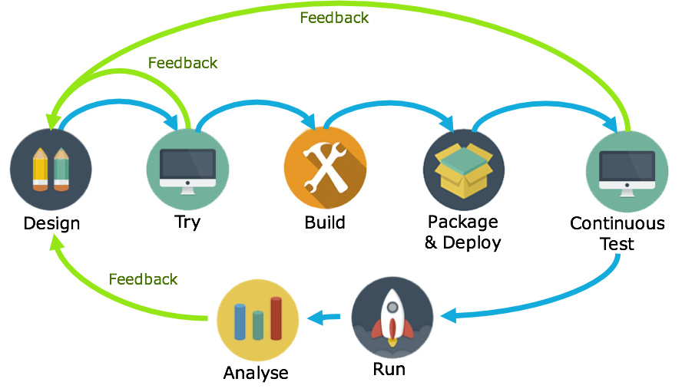
API-First
1
Avoid rework: feedback early in the cycle
By getting feedback very early in the lifecycle, changes of rework late in the cycle are slim. Saving time and cost.
2
Parallel development: Decouple App dev from Service dev
By defining APIs with API Blueprints or Swagger, app dev and service dev can occur in parallel.
3
Agile: be ready for change
By continuously verifying service builds against API definitions, non-compliant updates can be detected quickly.

Slide 21
API First? Hey wait, can’t we do better?
Shop Microservice
Order Microservice
{ }
Call PlaceOrderAPI
UI
Logic
API
Logic
State
Call UpdateStockAPI
Stock Microservice
sync request/response
{ }
async, event pub/sub
async request/response
State
API
Logic

Slide 22
3 mechanisms through which Services interact
Request-Driven (Imperative)
Event Driven (Functional)
Service
Command
”Order IPad”
boolean order(IPad)
Event
Consume
OrderEvent{iPad}
Logic
Query
”Retrieve my Orders
List<Orders> getAllOrders(for)
Event
Publish
OrderValidatedEvent{iPad}
State

Slide 23

Decoupling through Events – Much lower Coupling
Shop Microservice
sync request/response
async, event pub/sub
async request/response
UI
Logic
1) Raise
OrderRequested Event
2) Listen to OrderRequested Event
Event Hub
4) Listen to OrderConfirmed
Event
Order Microservice
Stock Microservice
{ }
{ }
API
Logic
State
3) Raise OrderConfirmed
Event
API
Logic
State

Slide 24

…. Event-(First) Driven
Event Monitor
Product Update
Product added to Shopping Cart
Shop
Products
Event Hub (Kafka)
Topic X
Topic Y
Topic Z
Topic Q
New Customer
Customer Profile Changed
Customer Sign In
Customers
Order Payment Received
Customer Frozen
Customer Loyalty Status Change
Order Create
Order Cancelled
Product Stock Update
Shipping News
Loyalty Program
Order
Logistics
Finance

Slide 25
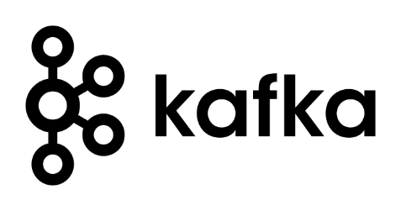
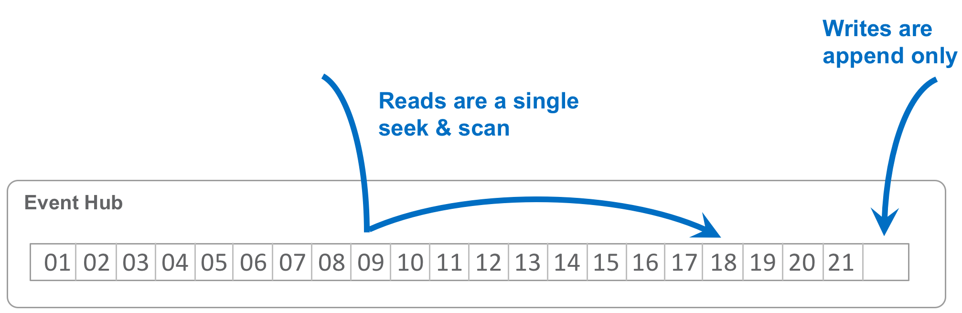
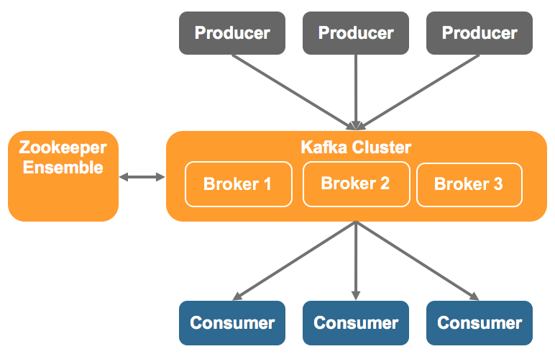
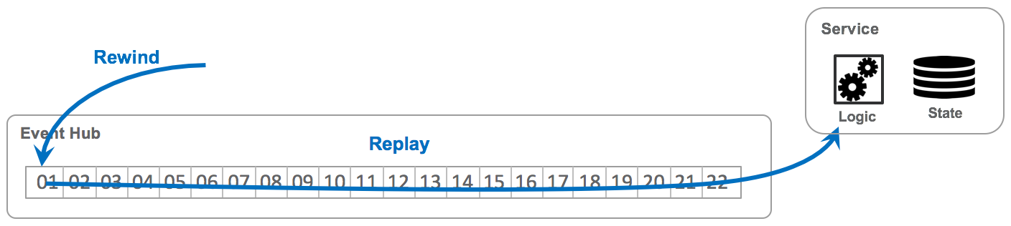
Oracle Event Hub CS – Managed Kafka
High-Level Architecture
Distributed Log at the Core
Logs do not (necessarily) forget

Slide 26
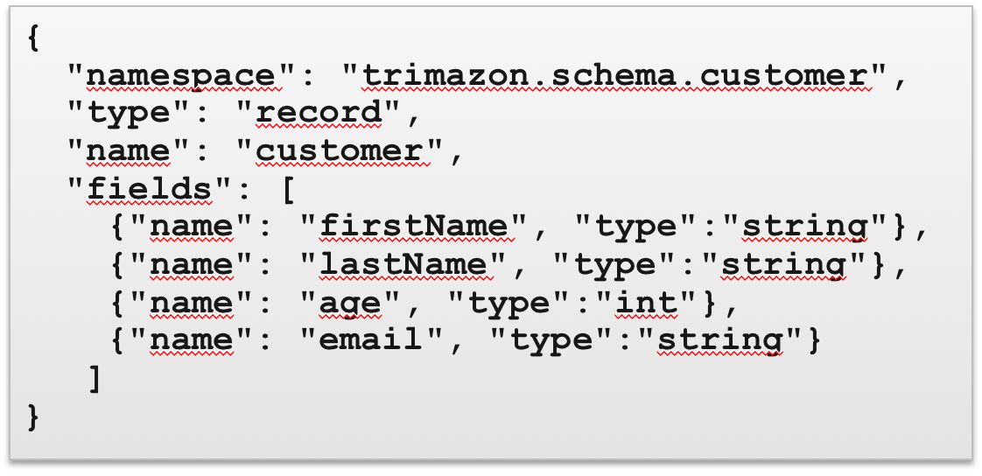
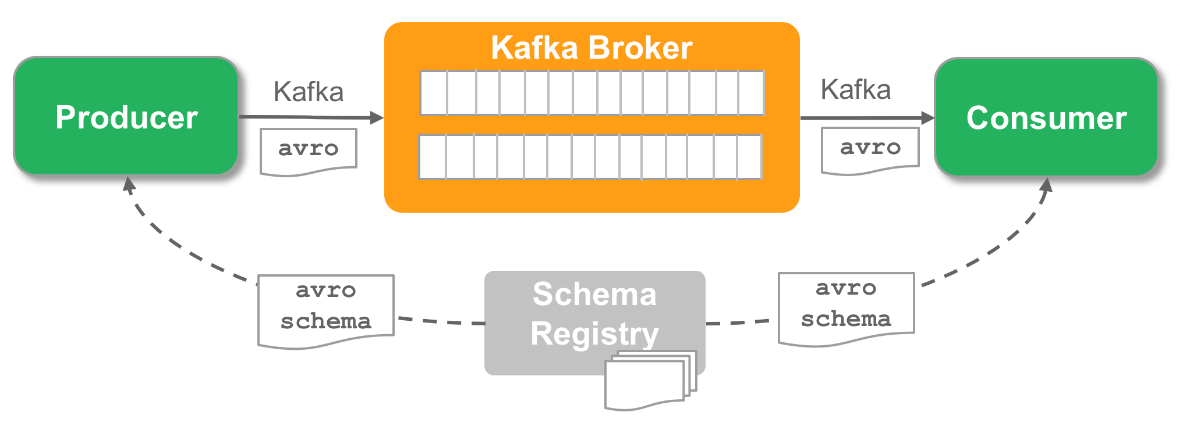
Avro and Schema Registry
Apache Avro
Data Serialization system well supported by Big Data ecosystem
Supports many languages
Fast binary data format
Supports schema evolution
Confluent Schema Registry
Provides Avro schemas to producer/consumer
Versioned history of all schemas
Serializers to plug into Kafka clients to work with Schema Registry
Provides REST API and Maven Plugin
Deployed on Oracle Container Service Classic

Slide 27
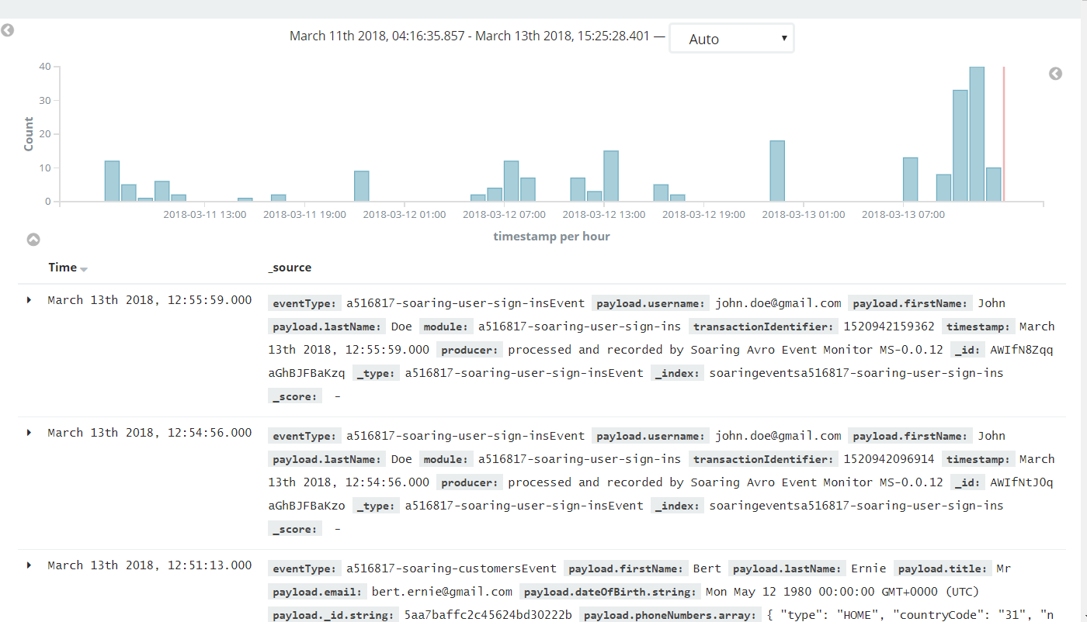
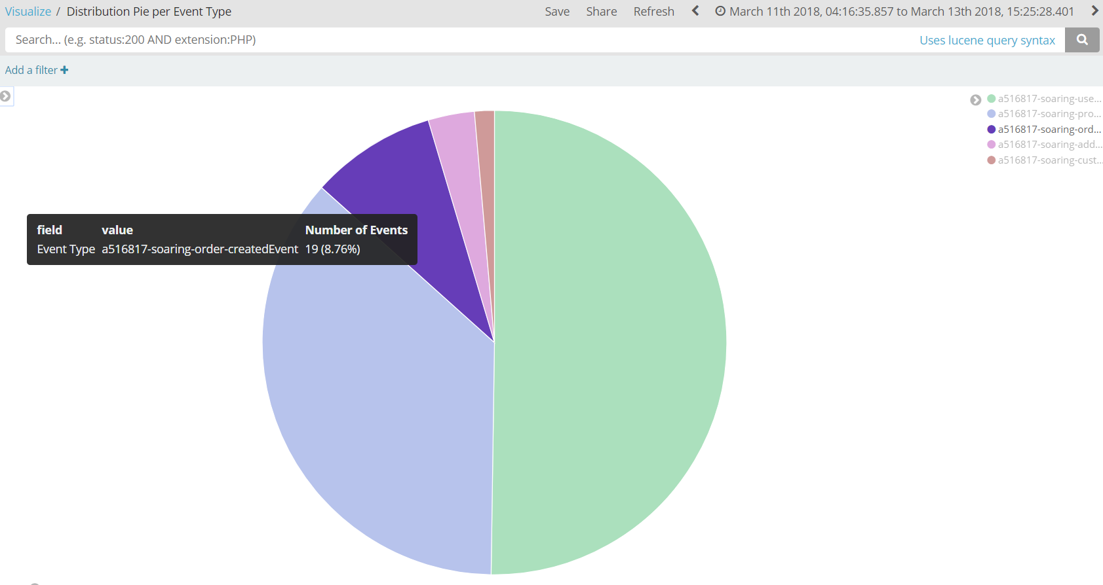
Demo Part
Schema Registry with Avro
Producing and Consuming Events
Re-Consume all Product Events
Kibana Dashboard

Slide 28
API-Design First
1
Avoid rework: feedback early in the cycle
By getting feedback very early in the lifecycle, changes of rework late in the cycle are slim. Saving time and cost.
2
Parallel development: Decouple App dev from Service dev
By defining APIs with API Blueprints or Swagger, app dev and service dev can occur in parallel.
3
Agile: be ready for change
By continuously verifying service builds against API definitions, non-compliant updates can be detected quickly.

Slide 29











The process looks something like this
Feedback
Feedback
Design
Try
Build
Package & Deploy
Continuous Test
01
02
03
04
05
Create API Blueprint/OAS in Apiary
Use Apiary Mock endpoints to publish an API through the Oracle API platform
API docs and mock endpoints available in the Dev Portal
JET designers/developers try the API and give feedback
Build backend service using tech of choice
Use Dredd to test endpoints against spec
Switch API Gateway routing against tested endpoints
Stablish a CICD pipeline for continuously and consistently packaging and deploying releases, e.g. using Wercker
Set up functional regression testing (e.g. using API Fortress or Postman) to ensure UI functionality doesn’t break due to API changes.
Oracle API Platform
Notes:
curl -X GET http://127.0.0.1:3000
docker exec -it 28f812bf8902 bash register.sh d2VibG9naWM6SUszQVcxbjU= https://oc-144-21-66-168.compute.oraclecloud.com:7202/apiplatform/management/v1/services http://oc-144-21-66-168.compute.oraclecloud.com:3000/orders
Administration: http://docs.oracle.com/en/cloud/paas/api-platform-cloud/apfrm/index.html
Management: http://docs.oracle.com/en/cloud/paas/api-platform-cloud/apfrm/index.html
Developer Portal: http://docs.oracle.com/en/cloud/paas/api-platform-cloud/apfrd/index.html
Gateway controller (not working…): http://docs.oracle.com/en/cloud/paas/api-platform-cloud/apfrg/index.html
Analytics: http://docs.oracle.com/en/cloud/paas/api-platform-cloud/apfra/index.html
Instance lifecycle management: http://docs.oracle.com/en/cloud/paas/api-platform-cloud/apfrl/index.html

Slide 30
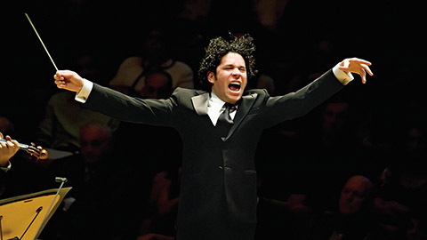

Cross Microservices Workflow
Choreography vs Orchestration – Which one is which?

Slide 31
Orchestration
Choreography
Store Web App
HTTP/JSON 200
{‘outcome’ = ‘processing’}
HTTP/JSON
Store Web App
Outcome
(Websocket, pushNot or Pull)
HTTP/JSON
HTTP/JSON 200
{‘outcome’ = ‘rejected’}
HTTP 202
Accepted
API Gateway
API Gateway
Process Engine
µService
Orchestrated Process
Receive Details
Credit Check
Process
Credit
Process
Credit
Receive Details
Check Credit Score
Good?
Yes
Reject
No
Process
Service
Event Hub
Credit Check
Process
Credit
Credit Check Event
Credit Check
Success
Credit Check
Failed

Slide 32
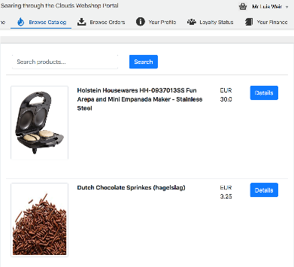
Orders Microservice
1
Items are added to shopping basket. Product MS adds items to topic “add-to-shopping-cart”.
Based on MEON (Mongo, Express, Oracle JET, Node.JS)
Oracle
Kubernetes
Engine (OKE)
(AD1) Container
AD2
AD = Availability Domains
2
AD3
”Product Subscriber Service” receives the items added. Then based on the Customer ID, checks if a Shopping Cart exists. If yes, adds the items to the basket. If no, creates a new Shopping Cart and then adds the item. This verifications occur by calling Orders Service via HTTP binding (but using K8s Service Name).
Orders
UI
3
API Gateway
Oracle API Platform Cloud Service
Ingress LB
3
A user initiates the checkout process. During the process, the UI interacts with not just Orders MS API, but other APIs such as Customer (for getting the Customer Details, and Logistics for checking stock availability and shipping price.
Container
HTTP Binding
(K8S DNS)
Container
HTTP Binding
(K8S DNS)
Container
API Gateway
Product
Subscriber
Service
Order
Producer
Service
Orders
2
4
Customer
Logistics
Container
Mongo
4
Once the checkout process completes, an assuming that all details of the Order are verified, then the Order changes status to “SUCCESS” and and event is added to topic “order-created”.
Logistics
Event Hub CS
Loyalty
1
5
Logistics, Finance and Loyalty MS pick up the event for further processing.
Finance
5

Slide 33

Storing state, is the database part of the MS?
Event Hub
Microservice
{ }
State
Logic
API
Event Hub
Microservice
Microservice
{ }
{ }
State
Logic
API
Logic
API

Slide 34
Storing state: noSQL or SQL
SQL
noSQL
Predefined structure
Structured language
Table based
Vertical scalable
Best fit for multi row transactions
Dynamic structure
Hierarchical structure
Document, key-value, graph
Horizontally scalable
Best fit for large and/or ever changing data sets

Slide 35
Storing state: the container
Part of the container
Outside the container
One MS, one container
One MS, multiple container
Microservice
Microservice
{ }
{ }
State
State
Logic
API
Logic
API
But it is still part of the bounded context: don’t connect to it directly from another MS

Slide 36
Example
Schema
Saving
Hooks

Slide 37
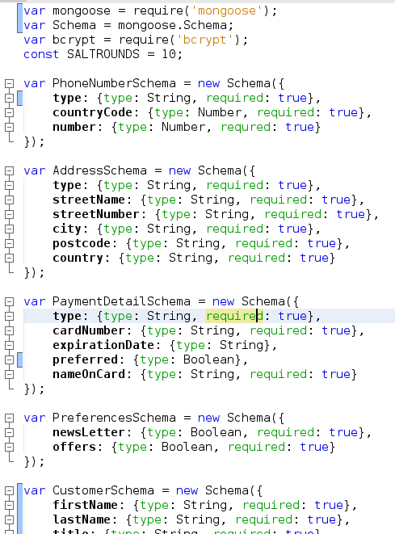
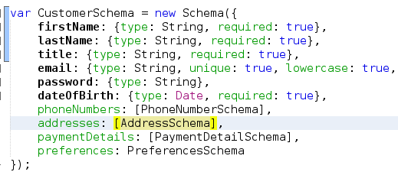

Slide 38
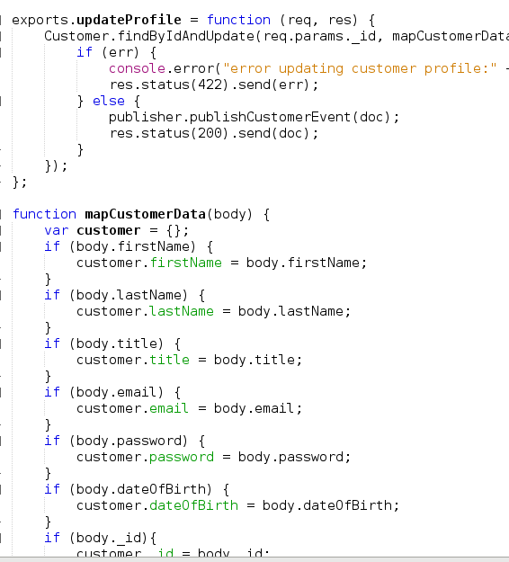

Slide 39
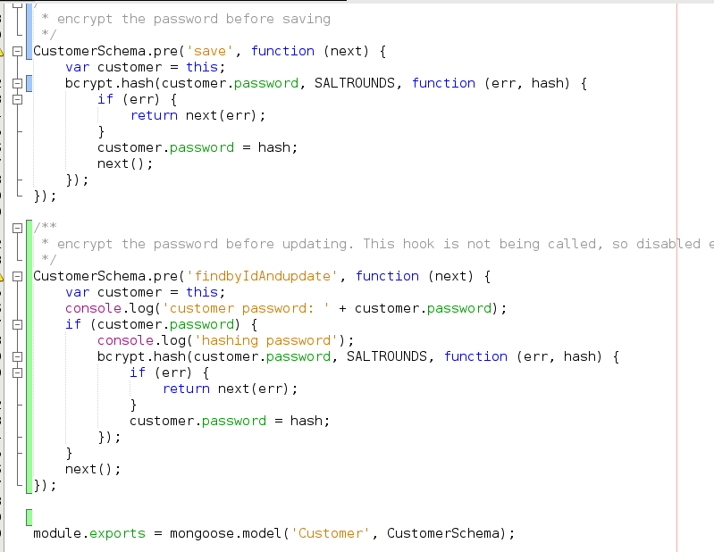

Slide 40
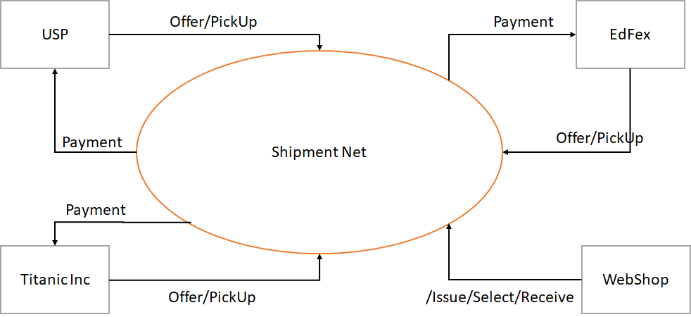
Blockchain setup

Slide 41
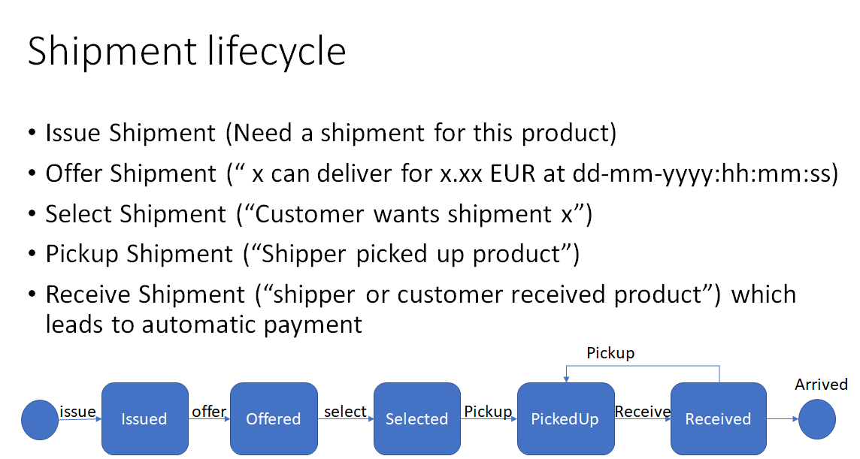

Slide 42
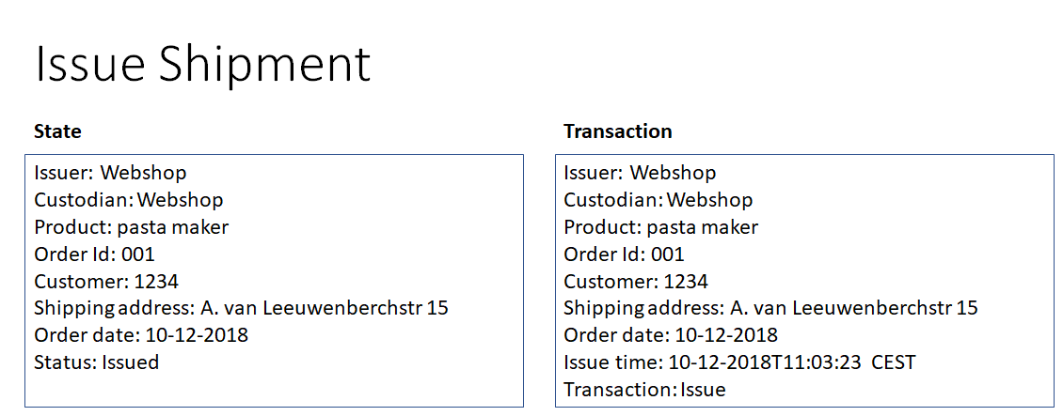
Blockchain state and transaction

Slide 43
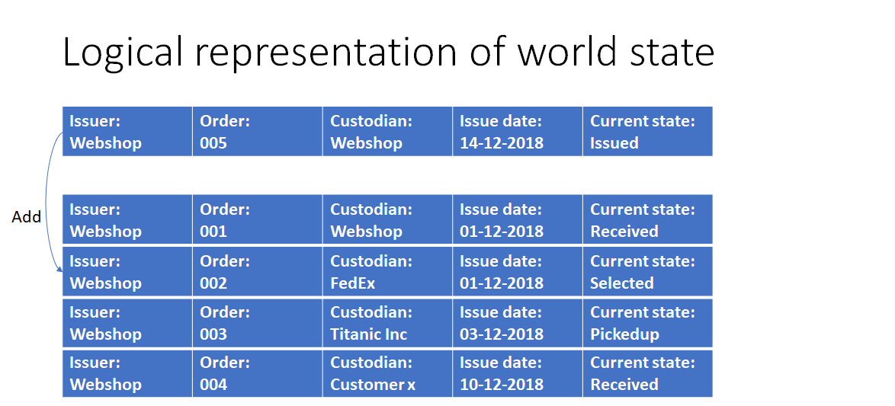

Slide 44
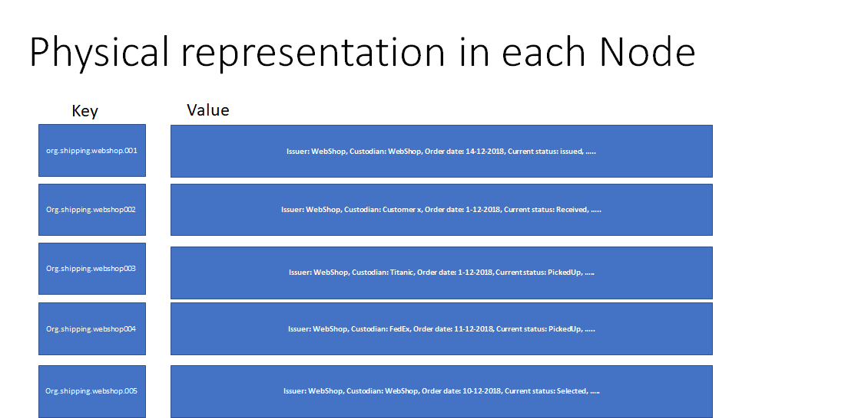

Slide 45
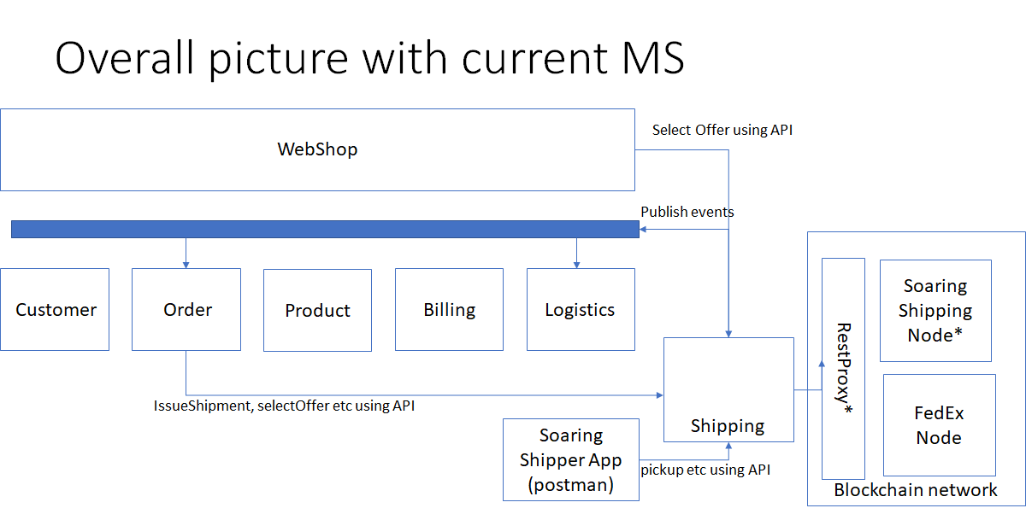

Slide 46

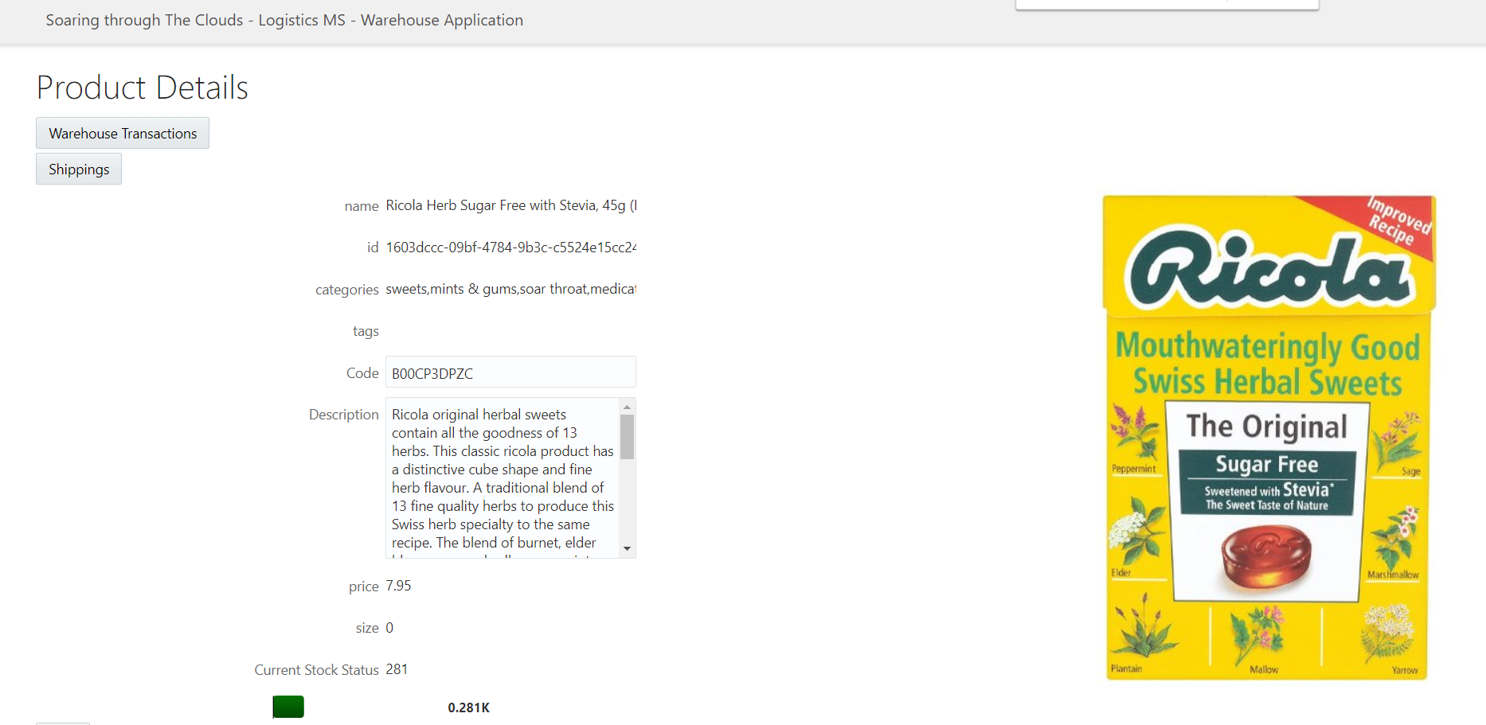
Rapid UI development using Next Gen VBCS leveraging the API change
Back Office UI for Logistics (built with VBCS against the REST APIs of the Logistics MS)
Objective: add a new page that shows all shippings that contain the selected product
Steps:
Create service connection for the new API Endpoint
Create a new page for shippings
Add table to page – based on the new API endpoint
Create button on Product Detail page to navigate to the new page
Run the application

Slide 47

Continuous Delivery and Deployment
Logistics MS
Change API definition
Commit and Push
Trigger build pipeline in Wercker
Show result in Kubernetes, K8S dashboard,
Proof that the change is there from call to API (in browser or postman)

Slide 48
Lessons Learned
An Architect has to be a Developer

Slide 49
Lessons Learned
An Architect has to be a Developer
Communication is essential – even if only about the touching points such as Events & APIs
Events are the backbone that allow decoupled interaction between independent microservices
EventHub CS (Apache Kafka) is the crucial backbone of our enterprise landscape
We need a more effective way to model choreographies. Who produces events, who consumes events, and chain of events. Both at design time and runtime
UI skillset is not same as backend service/API skills set. We can’t assume that everyone that’s a backend/API developer will want to learn UI skills.
Learning Kubernetes is absolutely required
Automating delivery of microservices is crucial
Fail fast, expect frequent failure of environments, introduce chaos deliberately (to learn how to deal with it)

Slide 50
Lessons Learned (page 2 / many)
Make sure all configuration settings (endpoints etc) are injected at deployment time and are NOT HARD CODED
To ensure scalability and quick redeploy and fail over, it is adamant that microservices are stateless
Data Bound(ed) Context makes Microservices independent
Every Microservice stores all data it requires – based on events, for example: Logistics MS stores physical product details (weight, size)
Getting Node JS to work with Kafka AVRO is special
HTTP Headers can be tricky – CORS, Frame Busting, API-KEY and more
Not all instances of an Oracle Cloud Service are created equally
Depending on region, version, time of creation, data center, and other attributes
Git skills are essential!
For debugging and troubleshooting (across asynchronous interactions) we need good tooling to gain insight – design time and run time
Automated regression tests are extremely important
…

Slide 51
Next steps – Business Functionality
Provide real time business [process] insight using Streaming Analytics (on the events)
Add advanced “search” capabilities in the UI – based on Elastic Search
Enhance User Experience
Machine learning powered product suggestions
Chatbot powered user interface
Send notifications to customers about order & shipping status updates
Orders History and Order Cancelling & Order Status Updates and Order Status History
Apply Loyalty Discount

Slide 52
Next steps – Architecture & Technology
Include TCO analysis
Consistently use AVRO event format throughout our services
Solve problems with API platform and add missing API implementations
Introduce a legacy or standard/SaaS application (and wrangle it)
For example an application for Product Configuration
Use Kubernetes as the generic deployment platform
Have a unified runtime platform for development – probably also based on Kubernetes (minikube)
Apply security – on APIs, on UI – authentication and authorization
How to do UI Mashup
Embrace Serverless

Slide 53
Next steps – Architecture & Technology
Do TCO analysis
Consistently use AVRO throughout our services
Solve problems with API platform and add missing API implementations
Introduce a legacy or standard/SaaS application (and wrangle it)
For example an application for Product Configuration
Use Kubernetes as the generic deployment platform
Have a unified runtime platform for development – probably also based on Kubernetes (minikube)
add management/monitoring to Kubernetes (e.g Istio, Zipkin, Grafana, Vizceral)
find a good solution for the workflow
add notification and push (server to client; server sent events & web sockets)
handle event production failure; handle historic event consumption
apply event sourcing?
strategy for splitting a microservice (for example break up Logistics MS into shipping and warehousing)
fully automated delivery pipelines for all components
automated regression testing of MS APIs
a way to test events (both production and consumption)
implement security - OAuth authentication, using IDCS for identity management, log in and authorization
have a central catalog for client events as well as enterprise events
embrace upcoming Oracle Container Engine Cloud
Build up a catalog of reusable components – such as JET composite components
Find a best approach for UI mash up
Embrace Serverless

Slide 54
2019

